Slide 1

Javascript
-By Internshipstation

Slide 2
Introduction
JavaScript is a scripting language designed to interact with the elements of web pages. JavaScript consists of three main parts:
ECMAScript that provides the core functionality.
The Document Object Model (DOM), which provides interfaces for interacting with elements on web pages
The Browser Object Model (BOM), which provides interfaces for interacting with the web browsers.
JavaScript is considered a "weakly typed" or "untyped" language. This means that JavaScript will figure out what type of data you have and make the necessary adjustments so that you don't have to redefine your different types of data.

Slide 3
introduction
JavaScript allows you to add interactivity to a web page.
You can use it to check or modify the contents of forms, change images, open new windows and write dynamic page content.
You can even use it with CSS to make DHTML. This allows you to make parts of your web pages appear or disappear or move around on the page.
JavaScripts only execute on the page(s) that are on your browser window at any set time.
When a web page is loaded i.e. after HTML and CSS have been downloaded, the web browser’s JavaScript engine starts executing the JavaScript code. The JavaScript code then modifies the HTML and CSS to update the user interface dynamically using DOM interfaces.
Before we go any further, let me say; JavaScript has nothing to do with Java.

Slide 4
History
JavaScript was created by Brendan Eich in 1995, which appeared in Netscape, a popular browser of that time.
JavaScript, often abbreviated as JS.
JavaScript, originally nicknamed LiveWire and then LiveScript when it was created by Netscape, should in fact be called ECMAscript (European Computer Manufacturers Association) as it was renamed when Netscape passed it to the ECMA for standardization.

Slide 5
syntax
JavaScript is case-sensitive
Everything in JavaScript including variables, function names, class names, and operators are case-sensitive.
It means that apple and Apple are two different variables.
Identifiers
An identifier is the name of a variable, function, parameter or class. An identifier consists of one or more characters in the following format:
The first character must be a letter (a-z, or A-Z), an underscore(_), or a dollar sign ($).
The other characters can be letters (a-z, A-Z), numbers (0-9), underscores (_) and dollar signs ($).

Slide 6

Comments
JavaScript supports both single-line and block comments. A single-line comment starts with two forward-slash characters (//), for example:
A block comment starts with a forward slash and asterisk (/*) and ends with the opposite (*/) as shown in the following example.
Statements
Although JavaScript does not require to end a statement with a semicolon (;), it is recommended to always use the semicolon to end a statement.
The reason is that the semicolon will make your code more readable and helps you avoid many issues that you may encounter.

Slide 7
How to start coding?
What you need to start coding JavaScript?
An IDE (eg. Visual Studio Code, Eclipse, Brackets if MacBook, etc)or any editor(eg. Notepad++, Sublime Text, etc.)
If Text Editor then a browser as well.

Slide 8
How to use JavaScript
To insert JavaScript into a HTML page, you use the <script> element. There are two ways to use the <script> element in an HTML page:
Embed JavaScript code directly into the HTML page.
Reference to an external JavaScript code file.
Embed JavaScript code in an HTML page
Placing JavaScript inside the <script> </script> element directly.
The JavaScript code in the <script> element is interpreted from top to bottom.
Include an external JavaScript file
First, create a file with extension of .js and place it in the js subfolder. Although it not recommended to do so but it is good practice.
Then, use the URL to the JavasScript source code file in the src attribute of the <script> element.

Slide 9
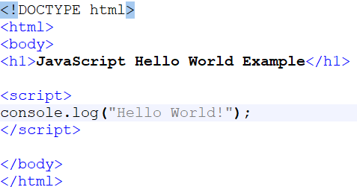
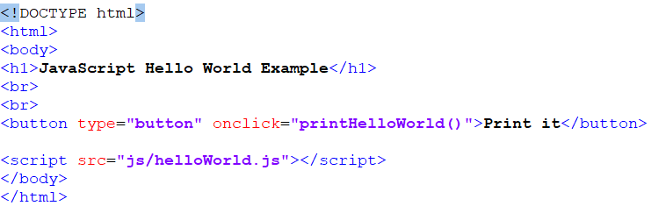
Let’s code!
Embed JavaScript code in an HTML page
Include an external JavaScript file

Slide 10
Overview of JavaScript
A variable in JavaScript:
var x = 10;

Slide 11

Digital Communications
Cloud
Local
Hybrid

Slide 12

Thank You

